Slide 1
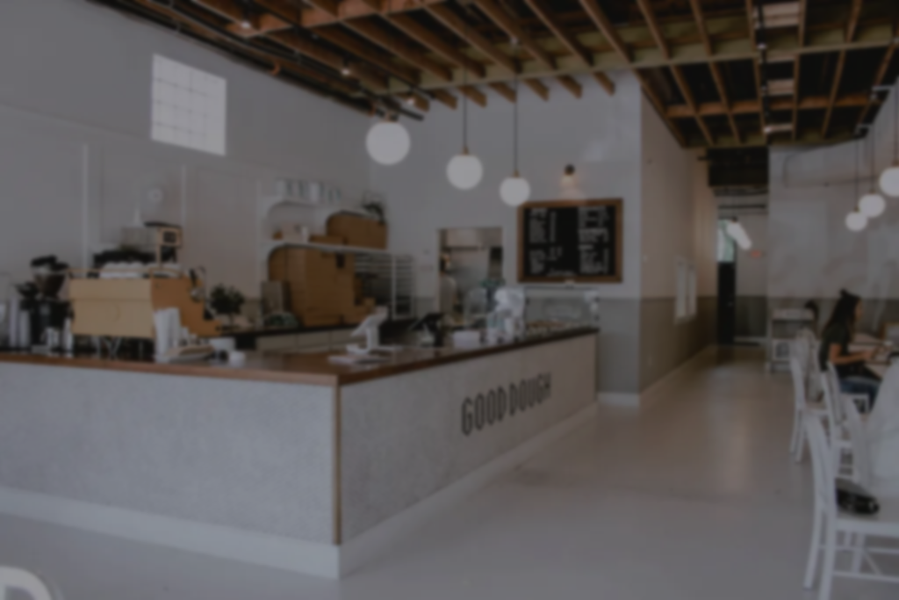
Start your day with a sip!
coffee shop
Expansion Analysis With SQL
Solving Business Problems with SQL

Slide 2
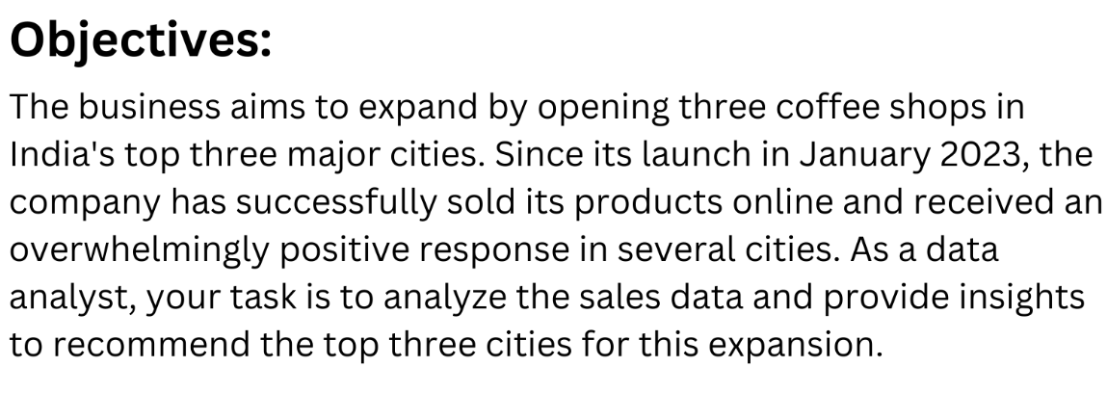

Slide 3
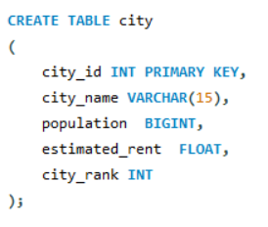
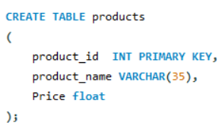

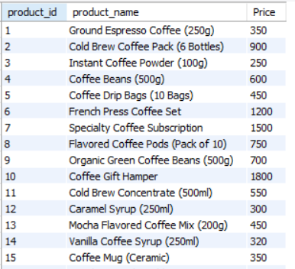
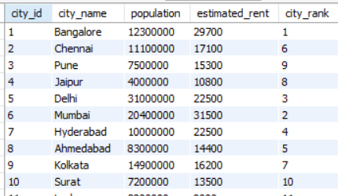
Table -2
Table – 1

Slide 4
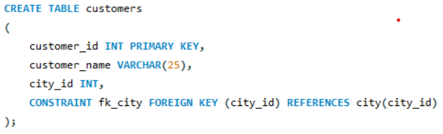
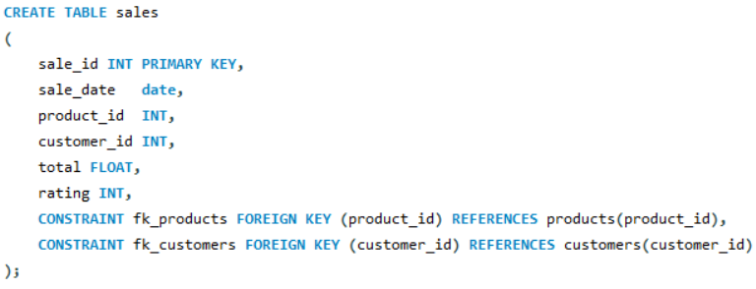
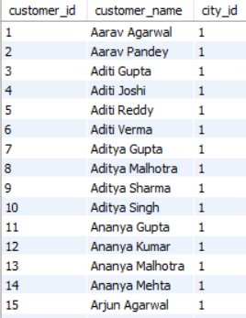
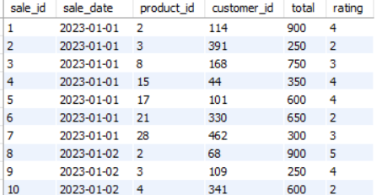
Table - 3
Table - 4

Slide 5
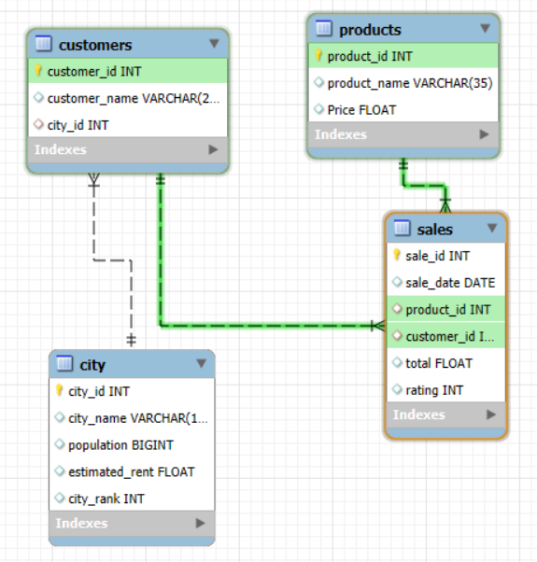
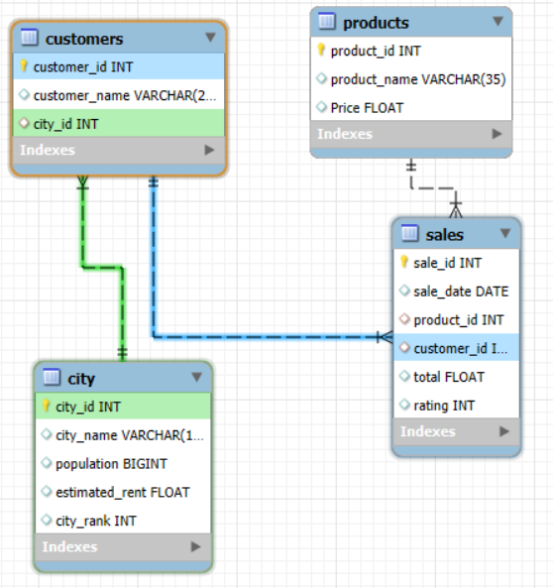
ER – Diagram :

Slide 6
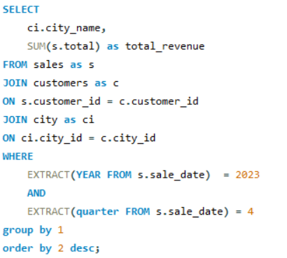
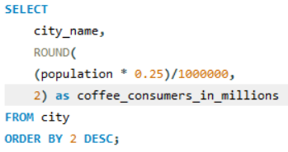
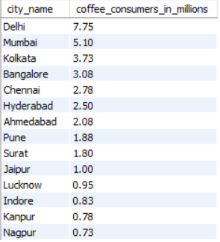
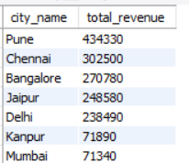
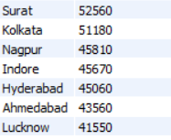
Key Questions :
2.Total Revenue from Coffee Sales What is the total revenue generated from coffee sales across all cities in the last quarter of 2023?
1.Coffee Consumers Count How many people in each city are estimated to consume coffee, given that 25% of the population does?

Slide 7
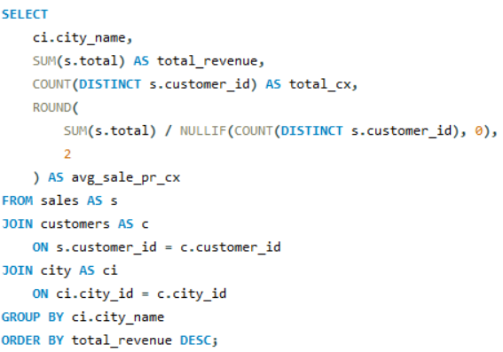
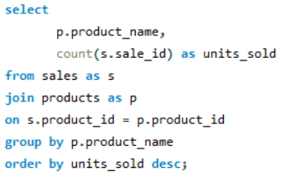
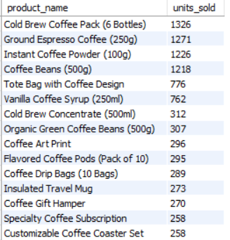
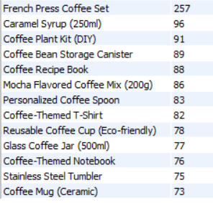
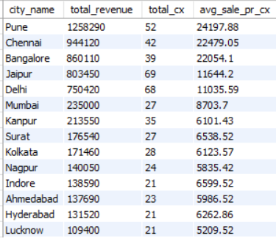
3.Sales Count for Each Product How many units of each coffee product have been sold?
4.Average Sales Amount per City What is the average sales amount per customer in each city?

Slide 8
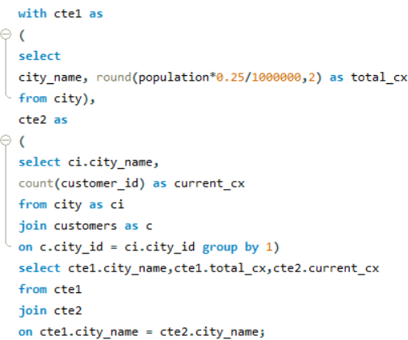
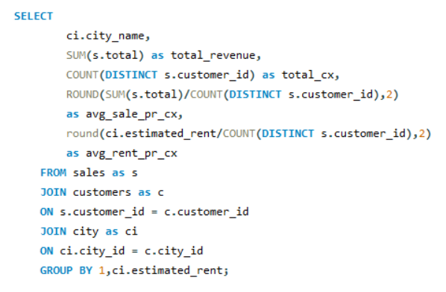
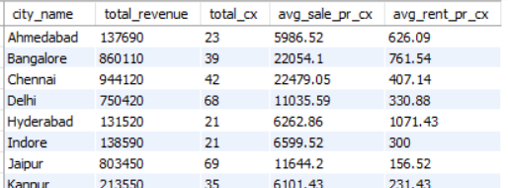
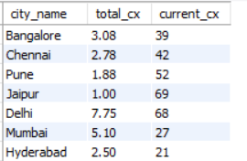
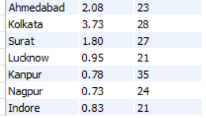
5.City Population and Coffee Consumers Provide a list of cities along with their populations and estimated coffee consumers?.
6.Average Sale vs Rent Find each city and their average sale per customer and avg rent per customer

Slide 9
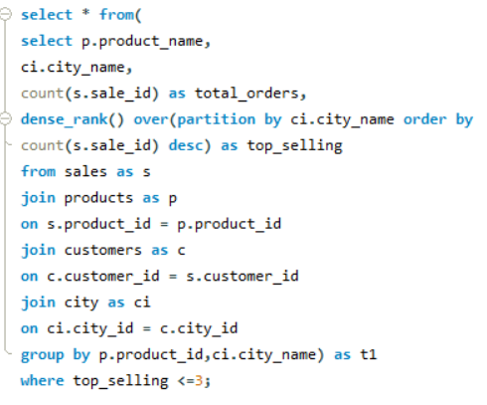
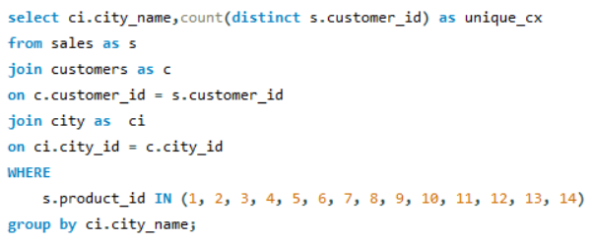
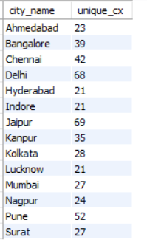
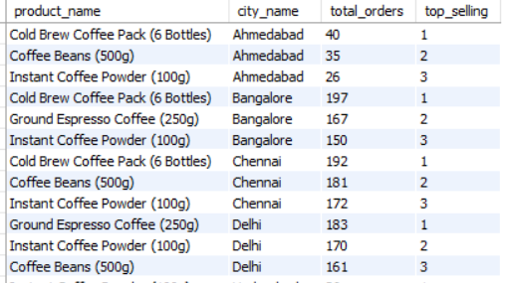
7.Top Selling Products by City What are the top 3 selling products in each city based on sales volume?
8.Customer Segmentation by City How many unique customers are there in each city who have purchased coffee products?

Slide 10
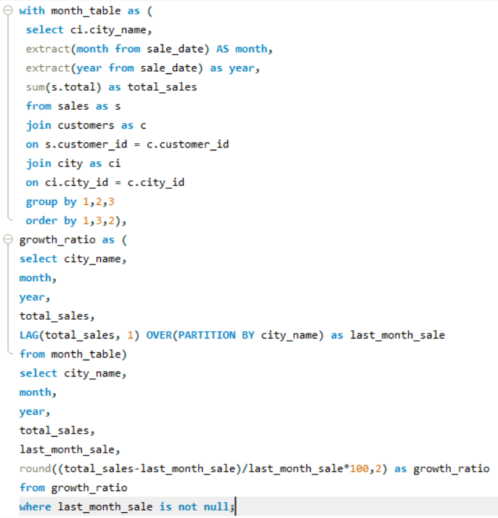
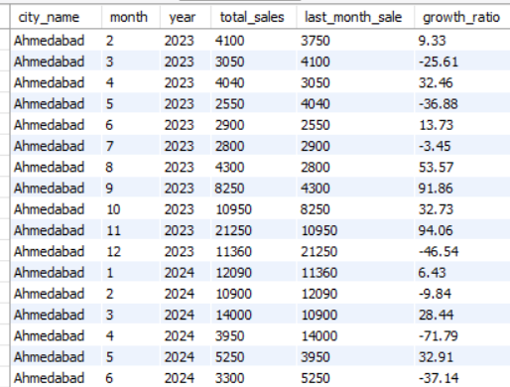
9.Monthly Sales Growth Sales growth rate: Calculate the percentage growth (or decline) in sales over different time periods (monthly).

Slide 11
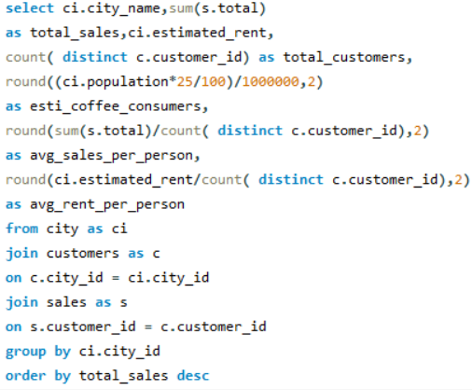
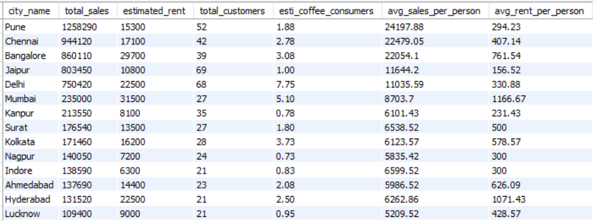
10.Market Potential Analysis Identify top 3 city based on highest sales, return city name, total sale, total rent, total customers, estimated coffee consumer

Slide 12
Recommendations :
After analyzing the data, the recommended top three cities for new store openings are:
City 1: Pune
Average rent per customer is very low.
Highest total revenue.
Average sales per customer is also high.
City 2: Delhi
Highest estimated coffee consumers at 7.7 million.
Highest total number of customers, which is 68.
Average rent per customer is 330 (still under 500).
City 3: Jaipur
Highest number of customers, which is 69.
Average rent per customer is very low at 156.
Average sales per customer is better at 11.6k.

